Slide 1
US LTER International Committee August 28, 2020 4PM EDT
AGENDA
Introduction of new co-chair and vice chair and thank you to/words from outgoing chair 5
Updates from the ILTER Network ExComm & Discussion 10
RoundTable Updates 15
New proposals or other collaborative opportunities 15
Action items for next meeting 10
Open floor 5
Schedule standing meeting
ILTER Committee drive:
https://drive.google.com/drive/u/0/folders/0ADbP4SNhwFt4Uk9PVA

Slide 2
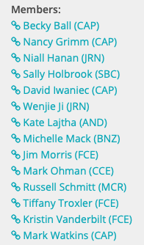
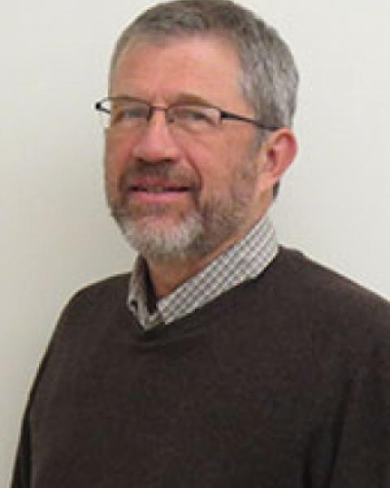
Introduction of new co-chair and vice chair and thank you to/words from outgoing chair 5
The U.S. ILTER Committee works to facilitate communication and improve research engagement between the U.S. NSF LTER network and the international LTER network.
THANKS BILL!!

Slide 3
Updates from the ILTER Network ExComm & Discussion 10
ILTER Strategic Plan
Annual Coordinating Committee Meeting (virtual) -- Committee co-chairs and SC Chair invited to participate in Coordinating Committee Meeting
Two days meeting | Two hours for each
November 11-12th
12:00-14:00 UTC
ILTER activities sought (e.g., DroughtNet, TeaBag)
ILTER Committee and regional reports
Americas and Africa regional networks
Open Science Meeting – begin inviting ideas
Venues of next CC meetings (Brazil 2021, China 2022, Serbia 2023)
COMMITTEE OPPORTUNITIES:
Stimulate new ILTER network activities
Help make connections or facilitate reactivation of Americans and Africa regional networks
Ideas for stimulating collaboration assoc’d w/ OSM

Slide 4
RoundTable Updates 15
Jenn Casselle - synthesis working group selection process and other special projects for the LNO
NATURA ILTER webinar

Slide 5
New action items, proposals or other collaborative opportunities 15
US LTER executive board meeting - Provide a short report and come up with a focused question or two to prompt discussion in the EB meeting – scheduled for October (report template and the reports from other committees here: https://drive.google.com/drive/folders/1cDidNyLYiJMXyJL6d_1Z8U5ugTLO-21x?usp=sharing )

Slide 6
Action items for next meeting 10

Slide 7
Open floor & Schedule standing meeting 5

