Slide 1
Slides from Gooseff Science Presentation at 2013 MCM Boulder mtg.
Adam Wlostowski just submitted (July 2015) a paper synthesizing the streamflow records for the past 20+ years
In preparation for that, he was analyzing in-season flow dynamics (but this got cut from the final version of the paper)
Contents that follow:
First 2 slides are about WHEN different quantiles occur during a season (it’s pretty variable),
3rd slide is zero-flow analysis (we haven’t looked for long-term trends in these but could).
Last 3 slides analyze the magnitude of different quantiles for each flow year and whether they are increasing or decreasing… Example for Commonwealth, and then a table at the end with some trend analyses for many streams…
→ Bottomline: high flows are higher after 2002 than before for most streams

Slide 2
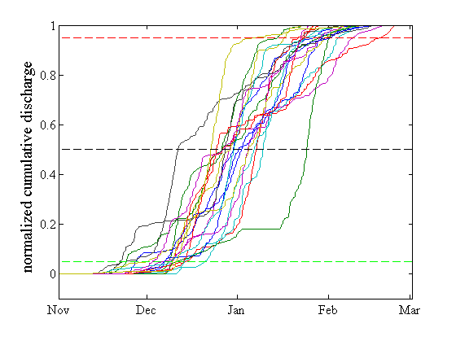
Analysis of cumulative discharge records (normalized)
Q₉₅ , t₉₅
Canada
Q₅₀, t₅₀
Q₅, t₅
Each line represents a single year of discharge data

Slide 3
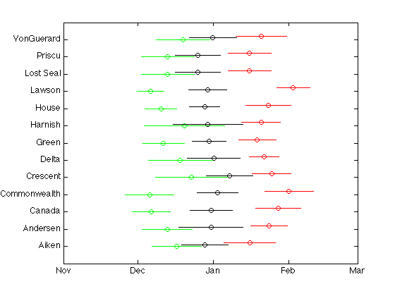
Analysis of cumulative discharge records (normalized) - timing
t₅ t₅₀ t₉₅

Slide 4
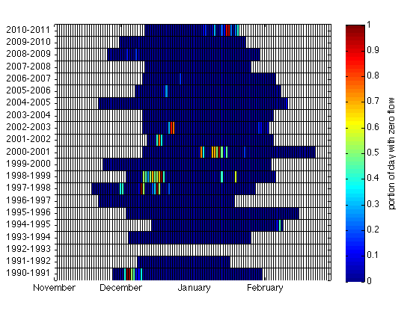
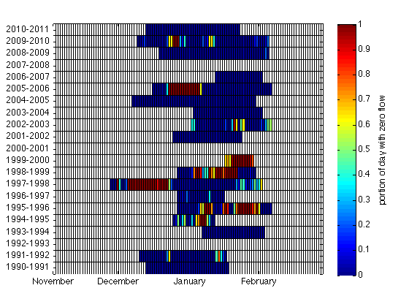
Zero-Flow Analysis
Canada
(short stream)
Crescent
(long stream)

Slide 5
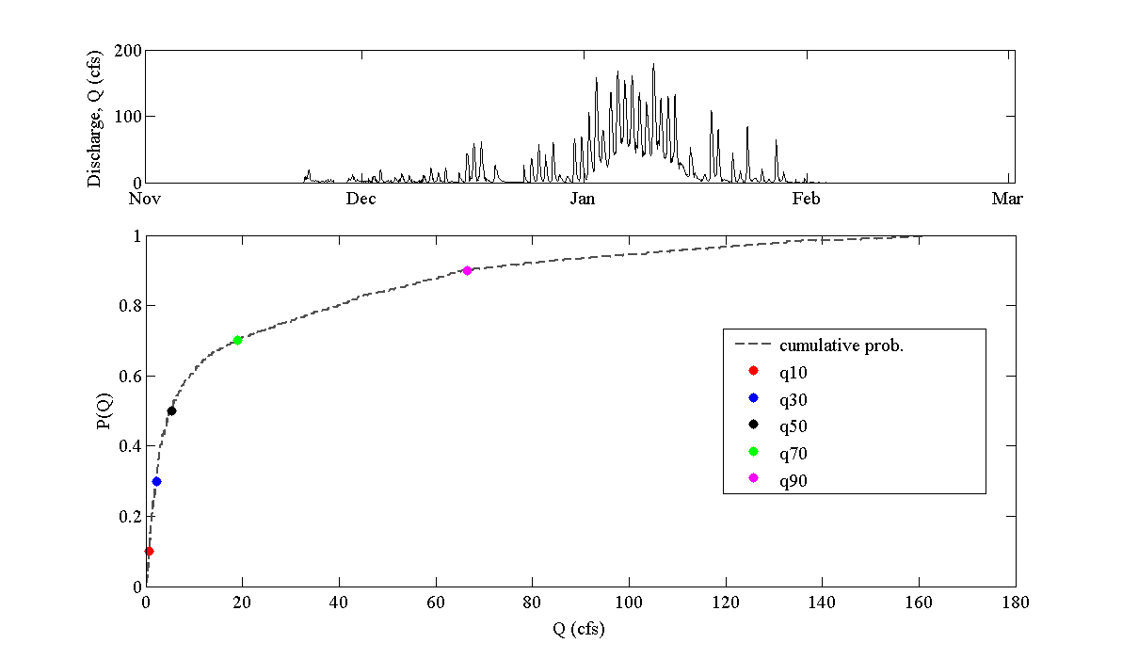
Seasonal Flow Quantile Analysis

Slide 6
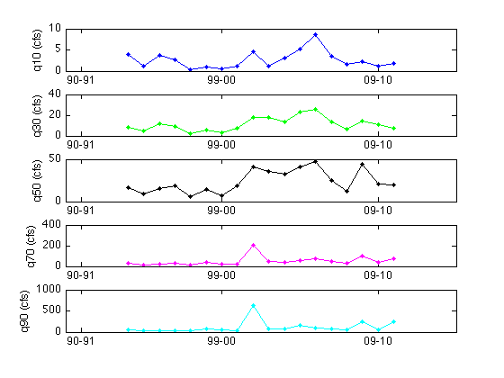
Seasonal Flow Quantile Analysis
Commonwealth
Low-flows
Median flows
High-flows
2001-2002 “flood year”
Notes:
An example of inter-annual shift in flow regime on Commonwealth. Plotting the time series of annual flow quantiles indicates a possible shift to higher flows following the flood year.

Slide 7
Seasonal Flow Quantile Analysis
 | Q10 | Q30 | Q50 | Q70 | Q90
Aiken | 0.2753 | 0.4598 | 0.237 | 0.122 | 0.0266
Andersen | 0.4234 | 0.1996 | 0.0927 | 0.0927 | 0.0003
Canada | 0.1823 | 0.3154 | 0.1823 | 0.0947 | 0.0435
Commonwealth | 0.1672 | 0.0055 | 0.0016 | 0.0001 | 0.0003
Crescent | 0.1011 | 0.0545 | 0.0545 | 0.0545 | 0.0676
Delta | 0.2786 | 0.065 | 0.1304 | 0.1605 | 0.083
Green | 0.1135 | 0.4363 | 0.1615 | 0.1903 | 0.0625
House | 0.0541 | 0.0012 | 0.0006 | 0.0012 | 0.0205
Lawson | 0.8665 | 0.5358 | 0.3969 | 0.1206 | 0.0289
Lost Seal | 0.6691 | 0.4173 | 0.1613 | 0.2295 | 0.0878
Priscu | 0.1672 | 0.1139 | 0.0206 | 0.0079 | 0.01
VonGuerard | 0.0635 | 0.1516 | 0.1767 | 0.1923 | 0.0766
 | significant difference at the 10% level
P-values from non-parametric rank sum test between annual quantile flows before and after the 2001-2002 flood year.
All streams show a significant (α = 10%) increase in the magnitude of high flows following the flood year.

