Slide 1
“Finding NIMO” (LTER Network Information Management Organization)
Latest Plans for a new LTER Data Management Function

Slide 2
Approach for this exercise
Consider new management models, but
Don’t throw away what currently works
Give IMs more opportunity to collaborate and participate in their own future
Allow for compensation for network contributions

Slide 3
Operating Principles
Provide a well documented set of core network information management services that support data preservation and re-use
Lower the barrier for adoption of network tools and systems
Prioritize investment based on information management or science needs – as determined by the entire IMC
Compensate site IMs for network-supporting service
Facilitate workforce training and mentorship to grow IM skills
Facilitate new collaboration models that improve efficiency
Develop strategies and approaches to serve the larger environmental research community

Slide 4
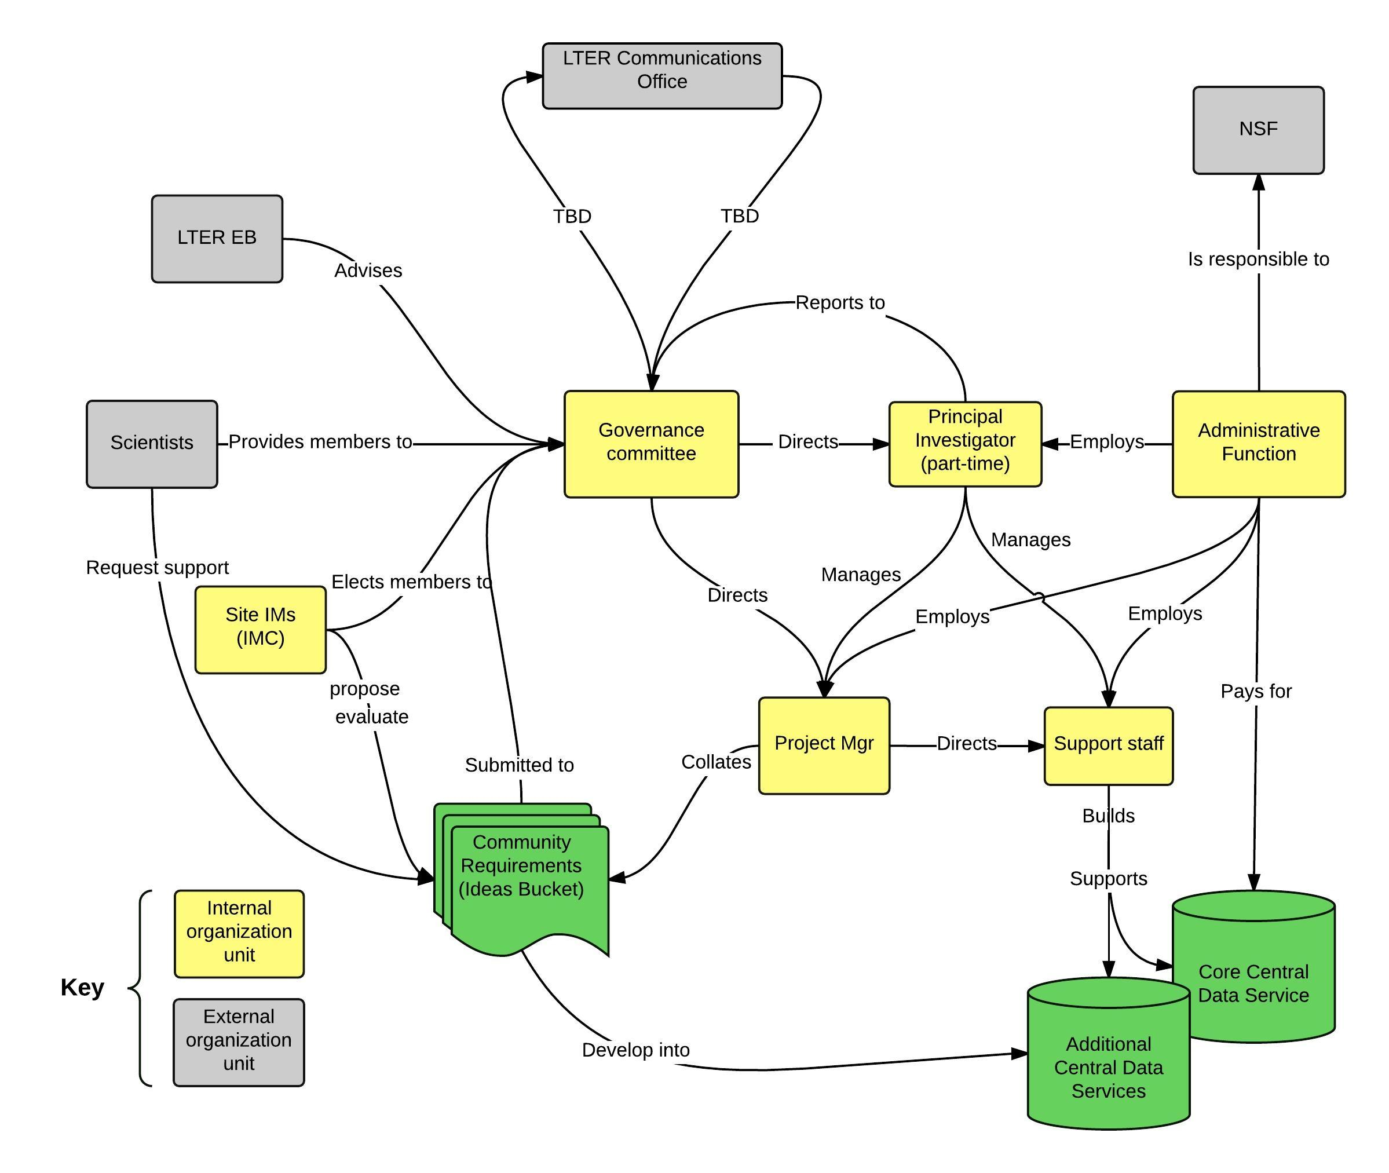
How will it work?
7 person IM Governance Committee (4 elected IMs [one is chair], 2 appointed scientists, PI. Ex-officio: PM, and IMGC chair-elect) manages activities with input from IMC and LTER community
Builds on our successful history of elected bodies serving the IM community while reducing “service load"
NIMO will provide core services and grow/develop network capability over time to meet changing needs

Slide 5
How will it work – IMGC?
Responsibilities:
Develop by-laws and procedures based on current IMC Terms of Reference (LTER IMC, 2011)
Establish System’s overall direction and goals
Manage overall budgets
Communicate with the IMC, EB, LTER CO, NSF, and Administration
Manage a decision making process based on IMC and advisory input to set priorities for
IT infrastructure
Software to be supported
Future architecture (web services, databases, etc.
Receive proposals for specific projects, and set priorities based on decision making process above. E.g.:
A site IM develops a tool or application which may have more widespread use
A site needs access to commercial software
A scientist asks for code or a data product to support a synthesis project

Slide 6
How will it work – Administration?
“Is likely to be a non-profit or one of the LTER host institutions with the goal of balancing reduced overhead with robust organization”
Responsibilities:
Owns the cooperative agreement with NSF
Hires personnel as directed by the Governance Committee
Reimburses LTER IMs for time spent on network projects
Administers subcontracts with universities
Administers funds for IT infrastructure and services as directed by the Governance Committee
Manages logistics for IMC working groups and specialized meetings
Organizes or facilitate training activities
Administers travel funds(?)

Slide 7
How will it work – Project Manager?
Responsibilities:
Makes sure the bills get paid
Project planning
Does not have the authority to decide “what” work is undertaken, only “how” the assigned work is completed
Tracks and reports project progress on behalf of the Governance Committee
Takes actions to ensure projects proceed as planned and within scope
Adheres to data management best practices

Slide 8
How will it work – Principal Investigator?
Responsibilities:
Part-time appointment
Acts as primary point of contact for cooperative agreement with NSF
Takes direction from Governance Committee
Advises the Governance Committee
Hires personnel as selected by the Governance Committee
Manages NIMO personnel (evaluations, vacations, terminations, etc.)
Manages finances in conjunction with Governance Committee

Slide 9
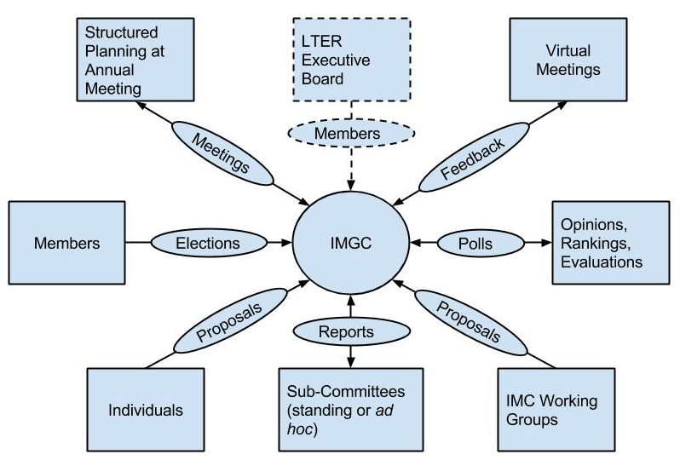
How will it work – communications?
Many of the communications channels and participation mechanisms you are used to
Plus:
Processes for submitting initiative proposals and participative planning

Slide 10
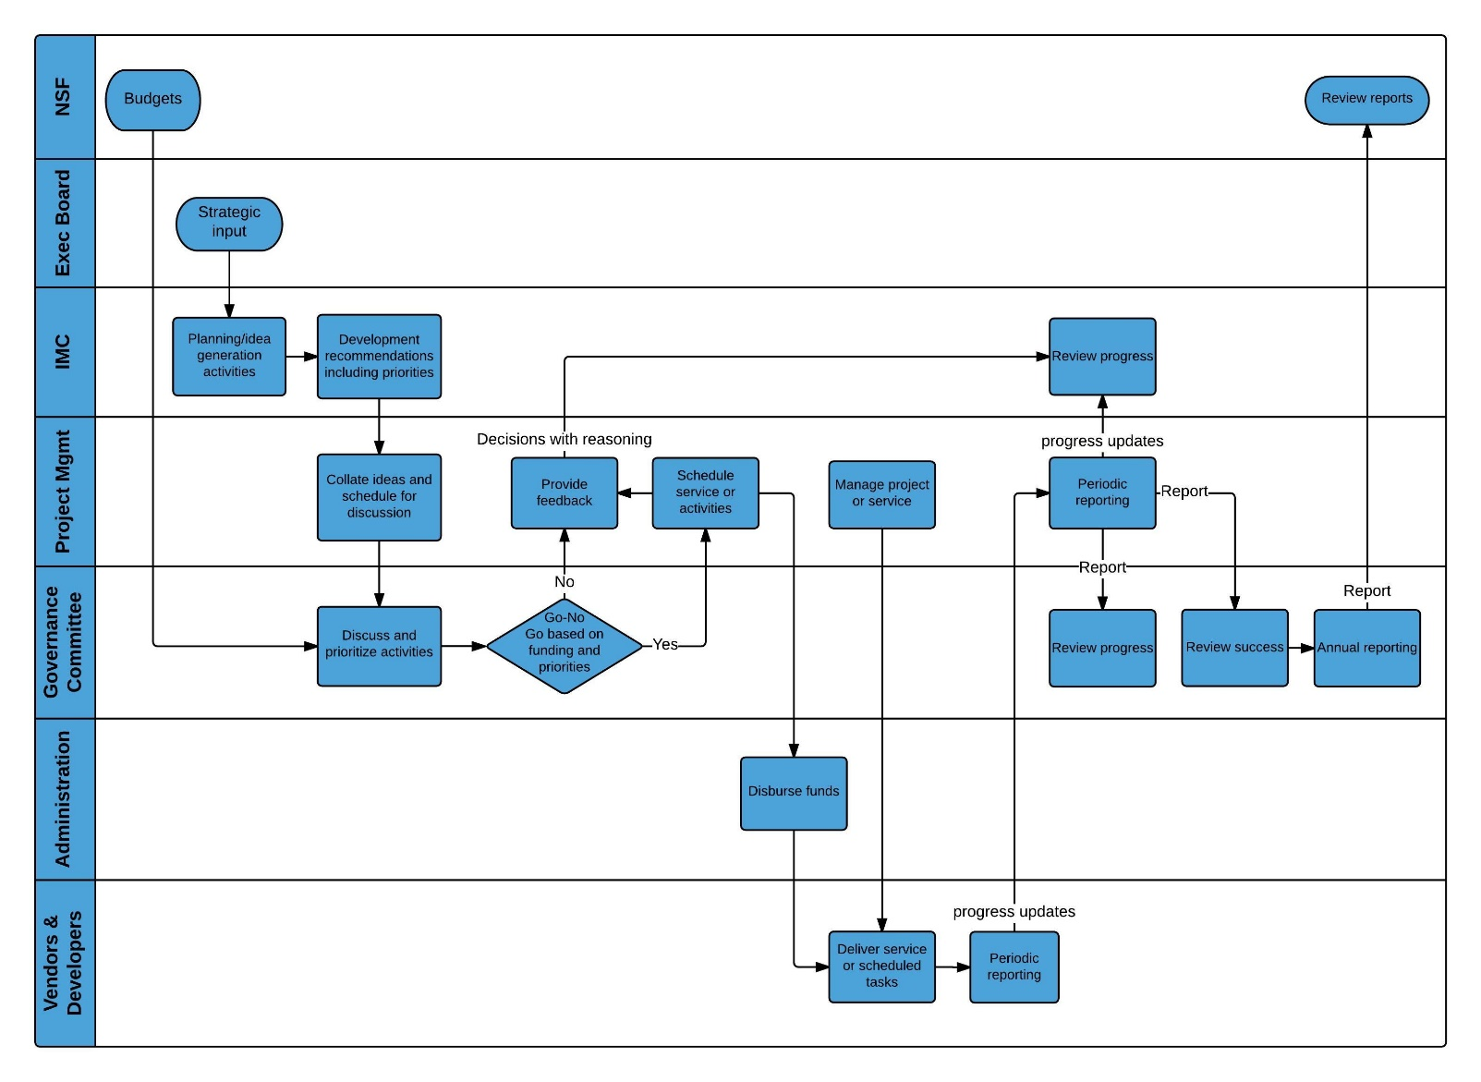
How will it work – high level process?
Planning conducted by IMC and IMGC with input from scientists, EB and NSF
IMGC will fund activities to the limit of budget based on pre-agreed priorities resulting from planning process(es)
Administrative project function will manage service delivery and funds

Slide 11
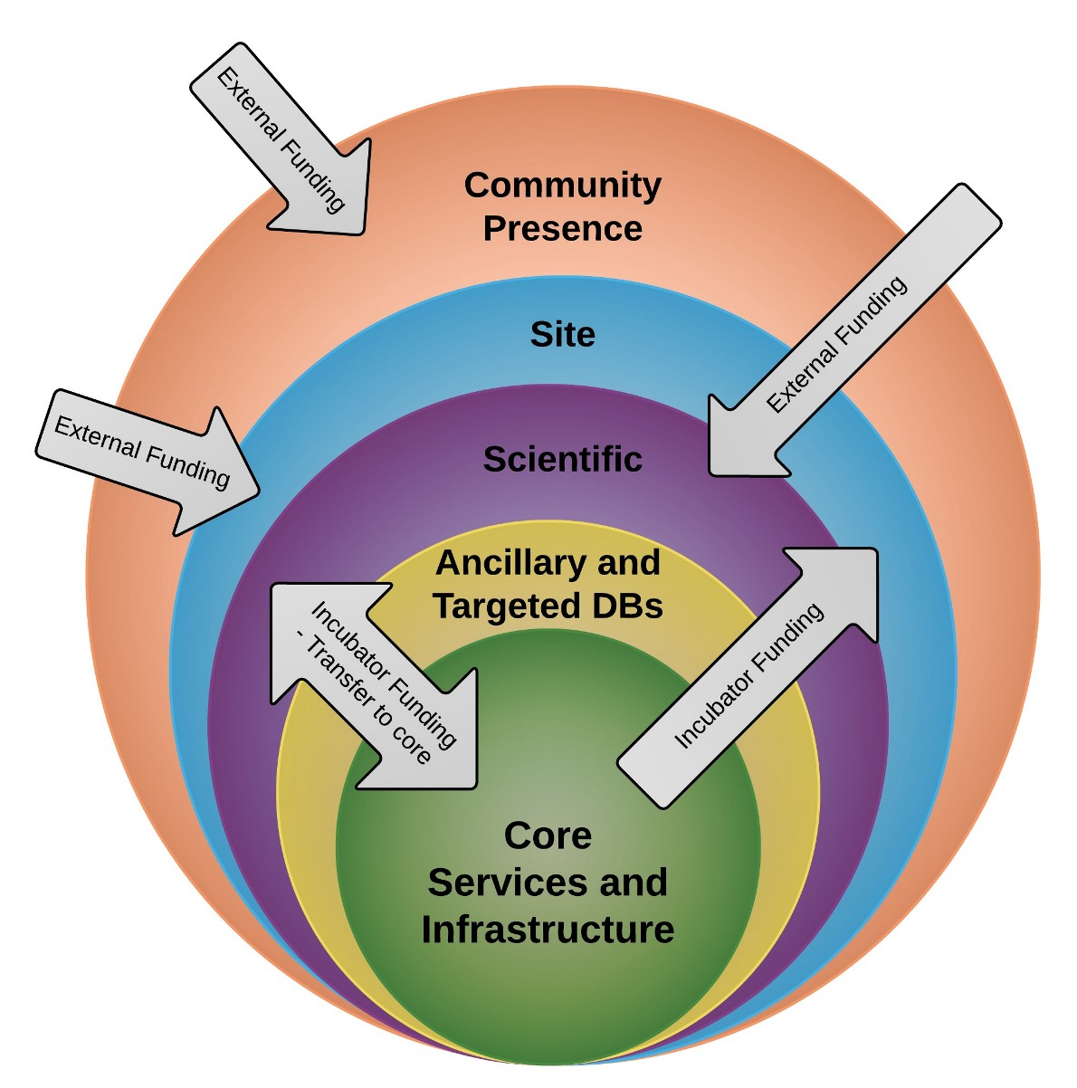
How will it work – layered services?
Layered services model will provide guaranteed core services to the whole LTER network while also funding “outer layers” such as targeted products, local initiatives and training based on network needs and potential future benefit to the LTER community
This “incubator” funding will allow promising technologies and services to be developed and migrated into the core over time

Slide 12
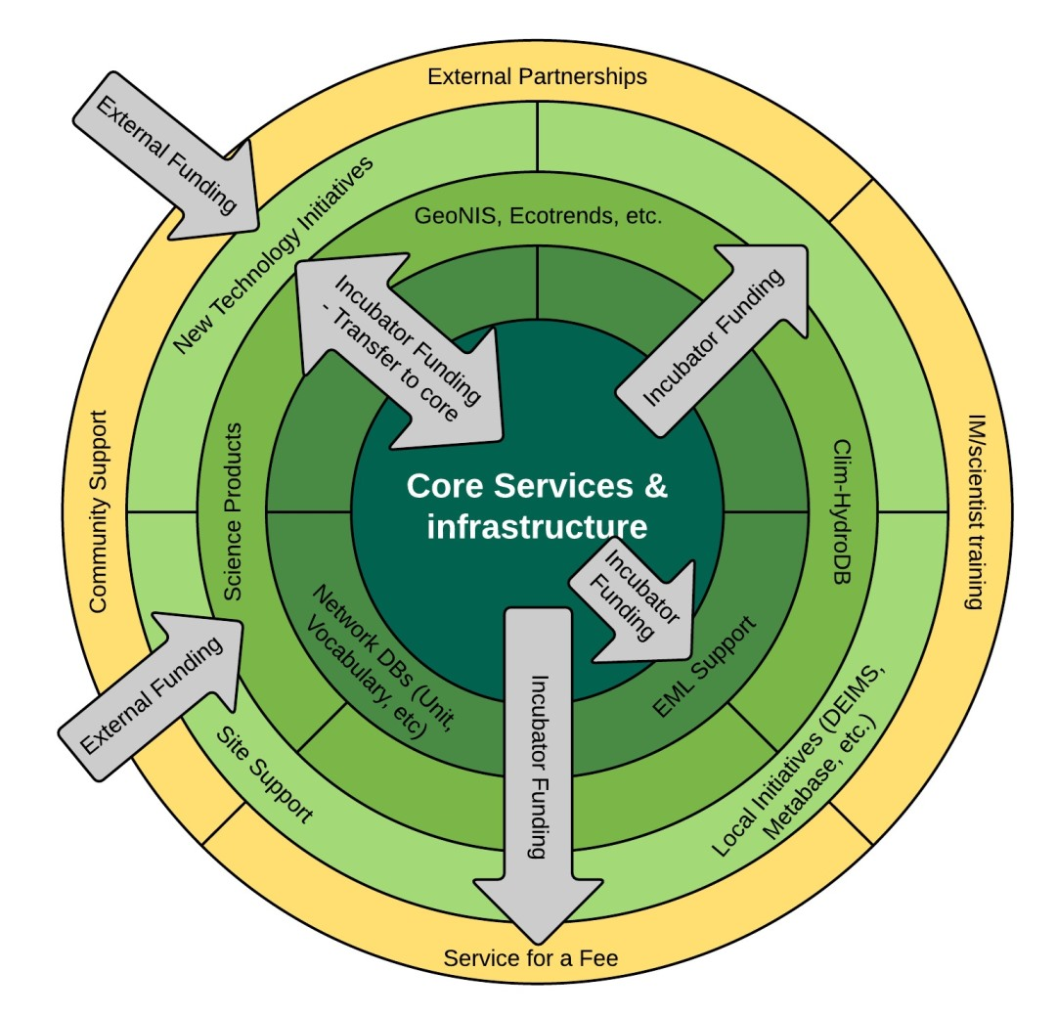
How will it work – layered services?
During planning cycles the IMC and IMGC will decide on which services and initiatives fit in each layer and agree which incubator-funded services can be affordably developed to benefit the whole IM community.

Slide 13
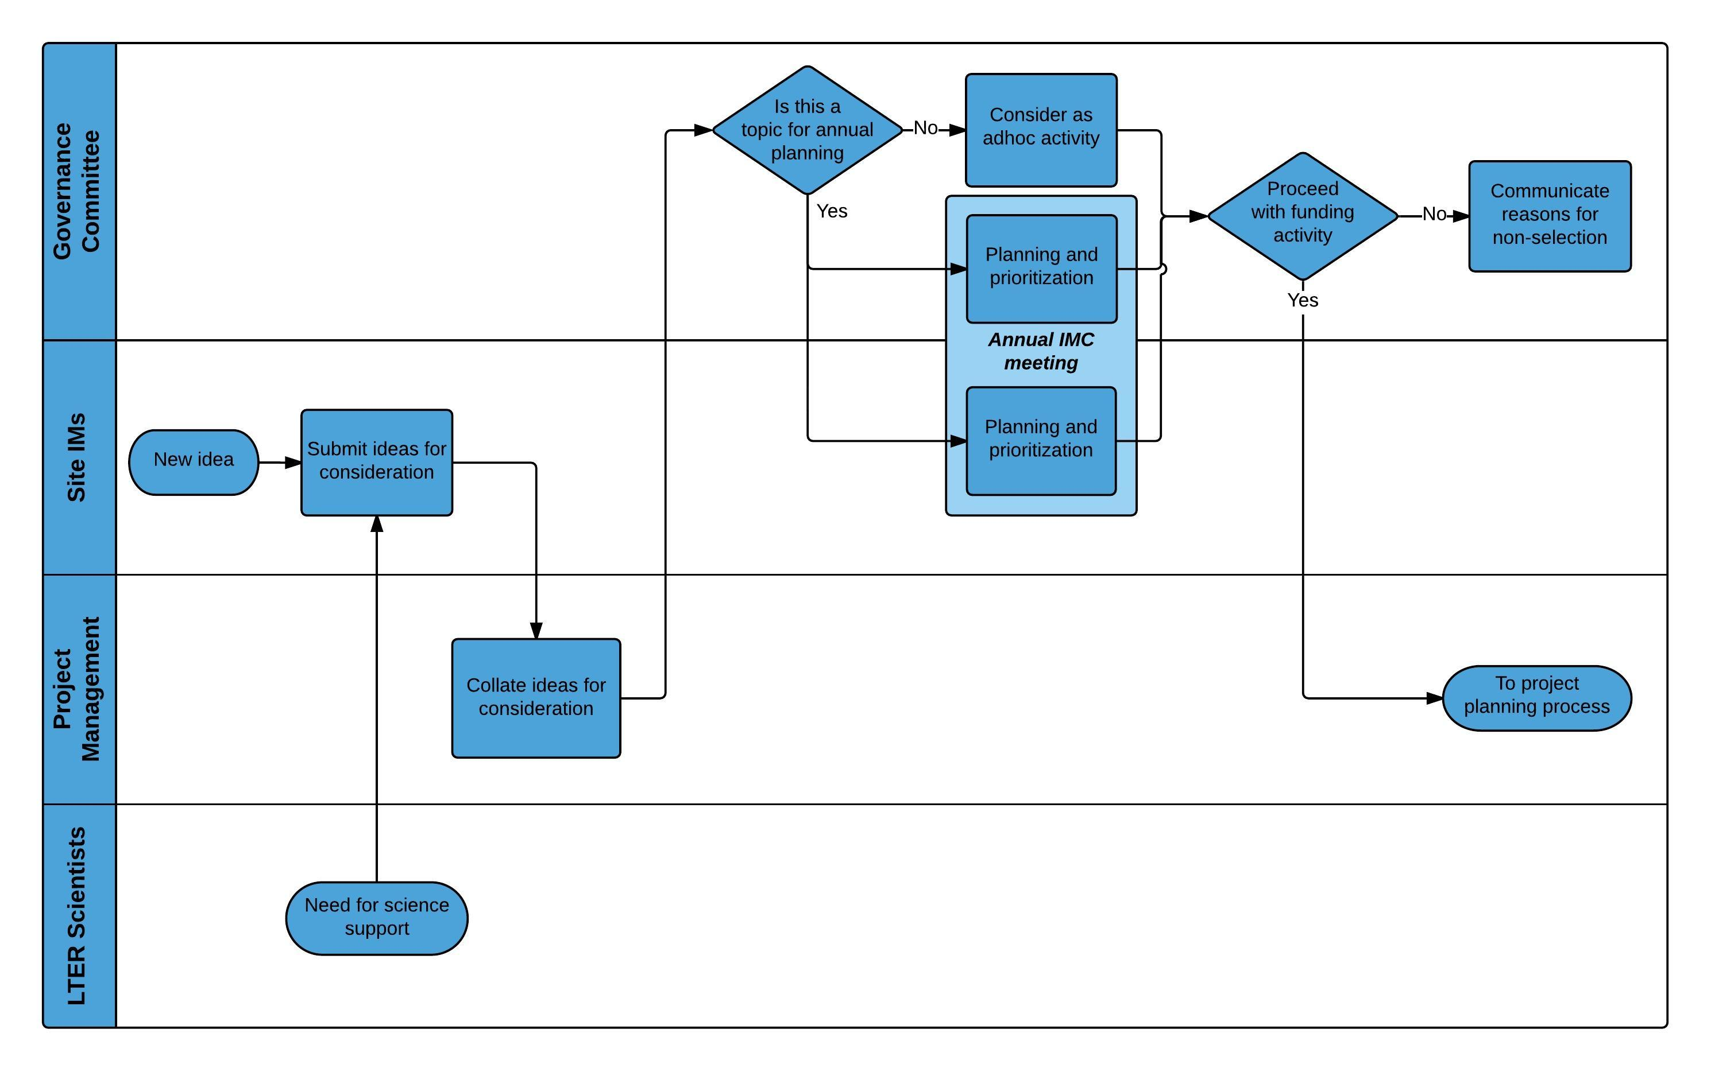
How will it work – project selection?
During annual (IMC meeting) planning cycles the IMC and IMGC will decide priorities for the coming year.
Ideas may be submitted at other times, either by solicitation or through adhoc IM/scientist input

Slide 14
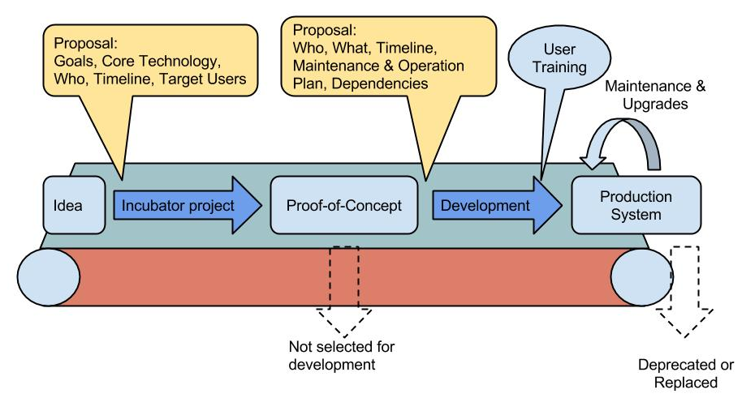
How will it work – service development?
Approved incubator-funded activities “flow” into the project schedule
Funds contribute to the development of “proof of concept” systems and services
These prototypes will be evaluated to see if they are suitable for broader deployment
Initiatives moved into production will be offered as network products and services

Slide 15
How will it work – Kumbaya?

