Slide 1
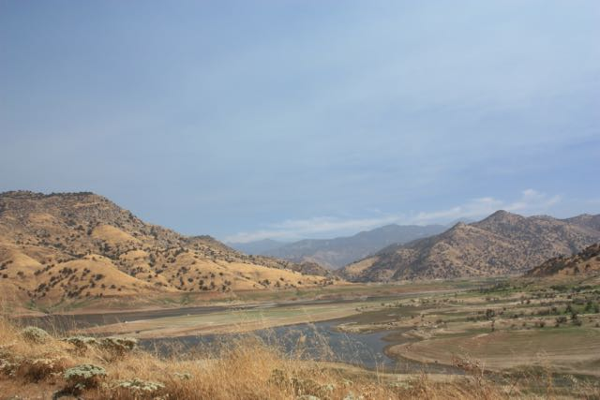
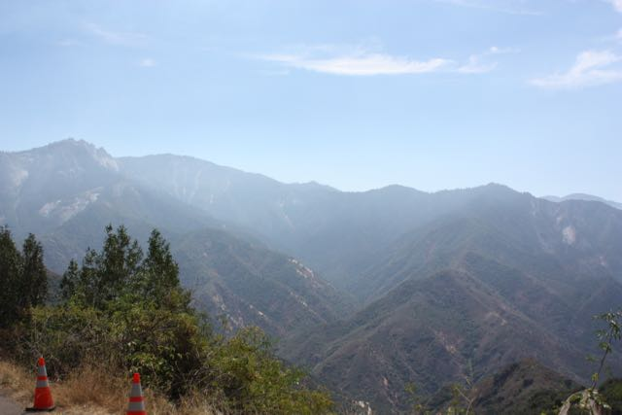
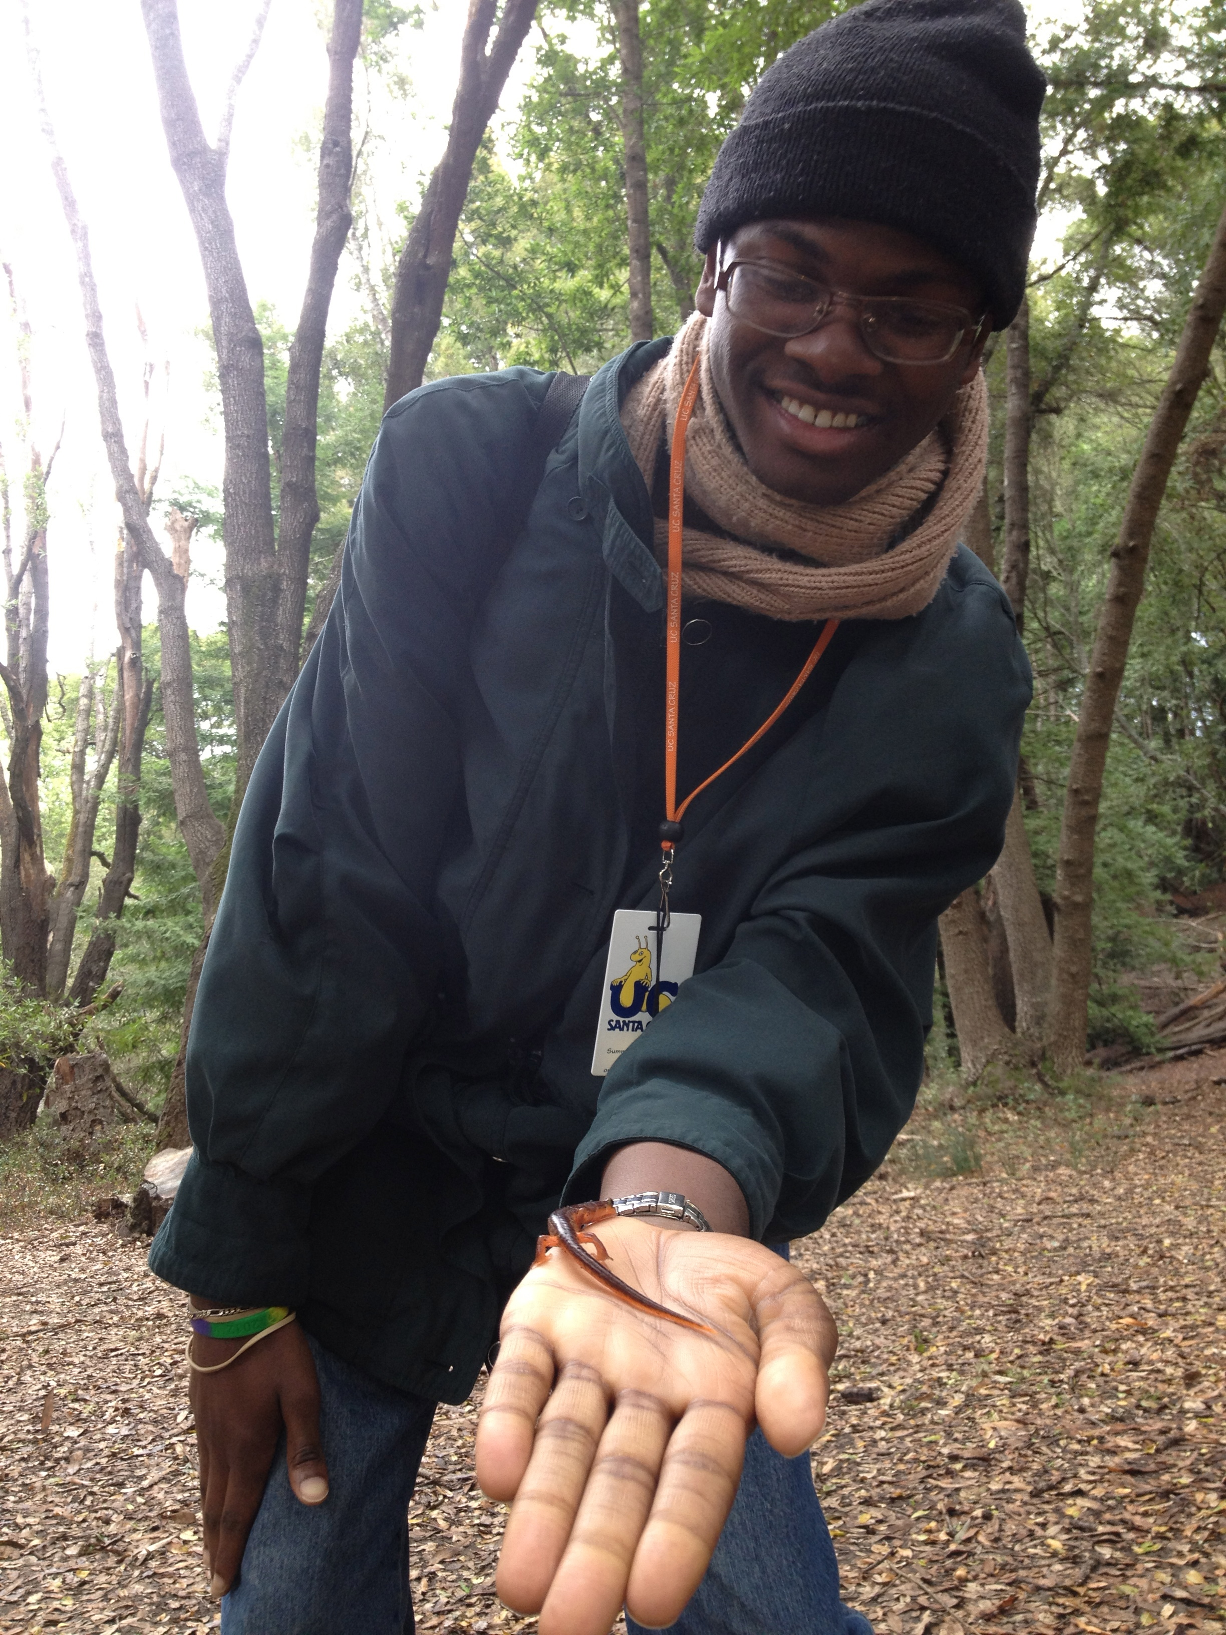
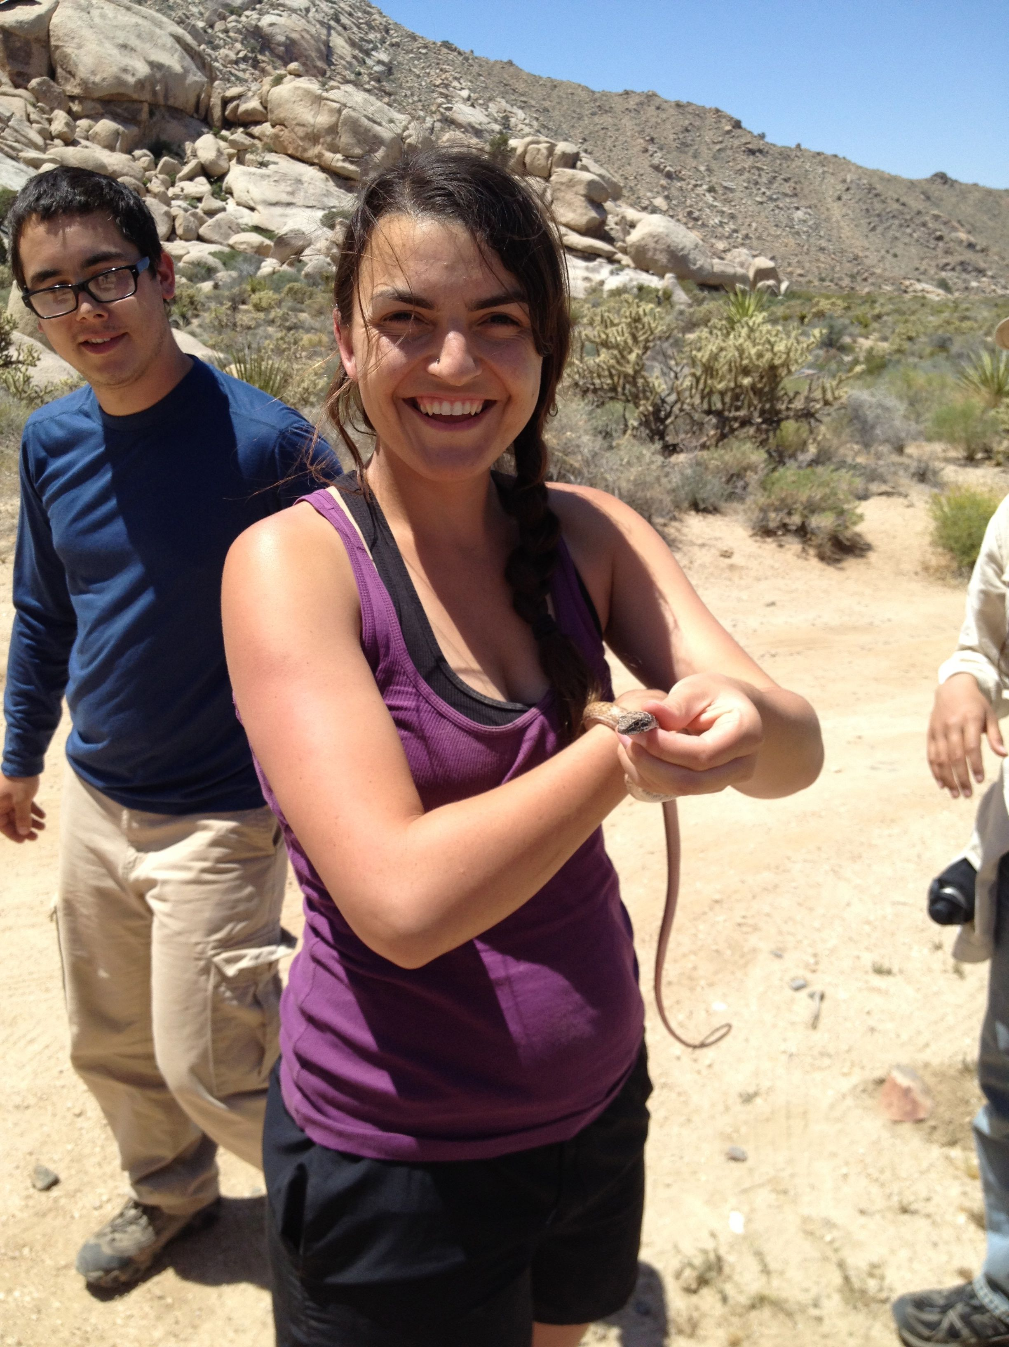
The UCSC Doris Duke Conservation Scholars Program seeks to prepare a diverse group of early-career students to lead the future of environmental conservation.
Student Experience: 2-year program
Year 1
Eight-week intensive summer field course
Winter professional development/ leadership workshop
Year 2
Eight-week, paid summer internship
Student Benefits
$4000 stipend each summer
Year-round mentorship from UCSC/home institution staff
Lifelong membership in Doris Duke Conservation Scholars professional network
For more information
conservationscholars.ucsc.edu
jacummin@ucsc.edu

