Slide 1
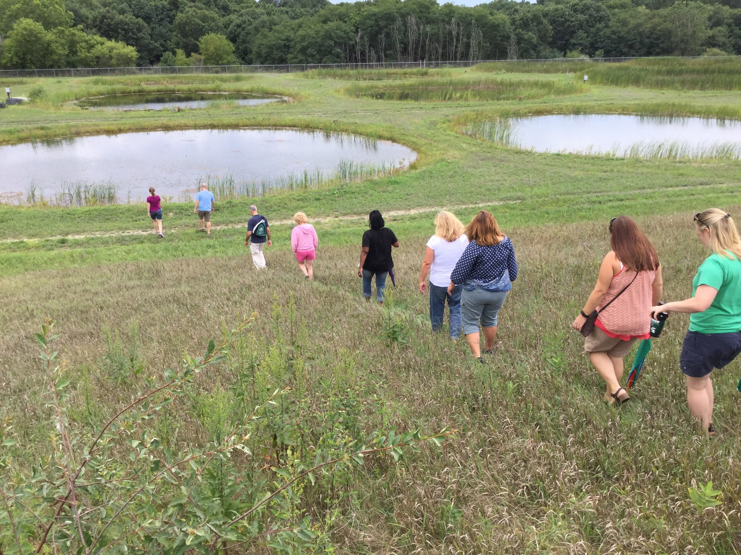
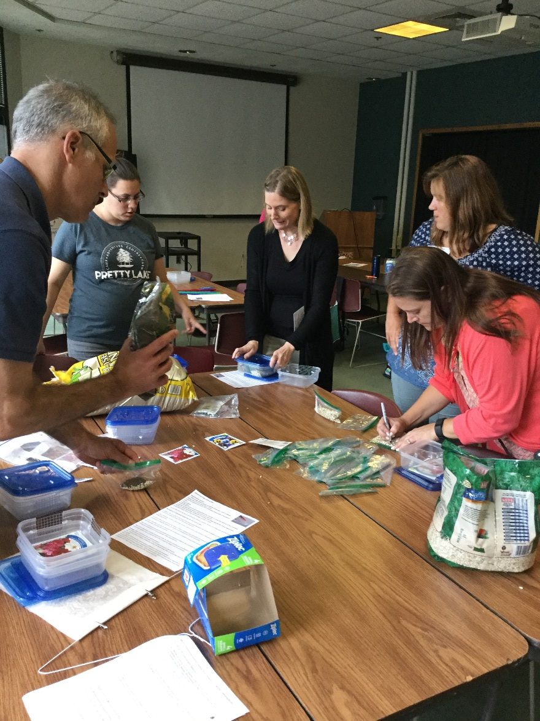
Teacher professional development
In the classroom or in the field, led by graduate students, faculty and partner teachers.
Notes:
At Kellogg Biological Station’s LTER we use schoolyard LTER funds to offer a professional development program (5 workshops days a year) for K-12 teachers. We have over 200 teachers from 20+ school districts in Michigan that participate. The KBS K-12 Partnership started in 1999 and has allowed us to leverage funds from within MSU (graduate school to fund grad. students as Outreach Fellows), EPA (environmental education grant to create a K-5 specific professional development, Teaching Science Outdoors), private donations, NSF DRK12 and GK12 grants (DataNuggets, BEST Plots). We also work to find funds to offer Research Experiences for Teachers each summer, many faculty use NSF broader impact funds and this summer we have a National RET program funded through NSF’s BEACON Center for the Study of Evolution in Action.

